Slide 1
Identify Poorly Performing Queries: Three Tools You Already Own
Grant Fritchey
DevOps Advocate
Redgate Software

Slide 2

Agenda
Understand the query performance tuning process
Learn about the importance of measuring query performance
Discover the three tools you can use to achieve these goals
Notes:
https://www.flickr.com/photos/rendzu/3451136570/

Slide 3





About me
Grant Fritchey
DevOps Advocate
Microsoft Data Platform MVP
AWS Community Builder
@gfritchey
grant@scarydba.com
scarydba.com

Slide 5

Easy Query Tuning

Slide 6
Actual Query Tuning

Slide 7
Capturing Query Metrics
Include Client Statistics
Connection Properties
SET STATISTICS TIME
QueryTimeStats in an actual execution plan
Query Store
Dynamic Management Views
Trace Events
Extended Events

Slide 8

Capturing Query Metrics
Dynamic Management Views
Extended Events (2012+)
Query Store (2016+)

Slide 9
Notes on Query Metrics
Have two points to compare
Use all the metrics, not just one
Execution plans are not a measure of performance
Don’t forget execution count

Slide 10
Dynamic Management Views
Ubiquitous (means they’re everywhere)
Easy
Aggregation only
Cache dependent
No comparison point unless you make one

Slide 11
Dynamic Management Views
Live
sys.dm_exec_requests
Sys.dm_exec_session_wait_stats
Cache
sys.dm_exec_query_stats
Sys.dm_exec_sessions
sys.dm_exec_XXX_stats
Both
sys.dm_exec_query_plan
sys.dm_exec_sql_text
sys.dm_exec_text_query_plan

Slide 12
Dynamic Management Views: A Cheaters Guide
Sp_whoisactive
Glenn Berry’s Diagnostic Information Queries
DBA Tools

Slide 13
Extended Events
2012+
Ubiquitous (2012+)
Lightweight and low cost
Superior filtering
Stored on the server
Functionality not available anywhere else
The most detailed data
Also, the costliest

Slide 14
Extended Events
Session
Events
Actions
Predicates
Targets

Slide 15
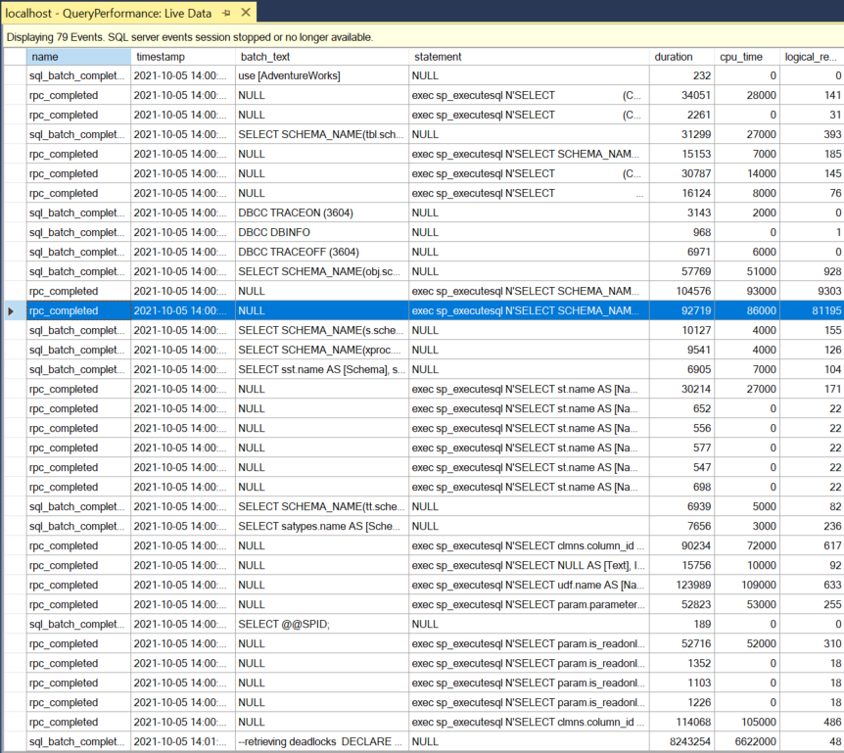
Extended Events: Learn The Live Data Explorer

Slide 16
Extended Events: A Cheaters Guide
DBA Tools
Workload Tools

Slide 17
Query Store
2016+
Azure SQL Database
Fairly lightweight
Database driven
Thorough information provided
Aggregation only, but broken up by time

Slide 18
Query Store
Query Optimization
Process
Plan Store
Async
Plan forcing
Query Execution
Runtime Statistics
Async

Slide 19
Demo!

Slide 20
Capturing Query Metrics
Dynamic Management Views
Extended Events (2012+)
Query Store (2016+)

Slide 21
Further Knowledge
Dynamic Management Views
Quick Start: Extended Events in SQL Server
Monitoring Performance By Using the Query Store
Query Store for SQL Server 2019
SQL Server 2017 Query Performance Tuning
Extended Events Live Data Window

Slide 22
Images, All Creative Commons
1 to 10 Numbers PNG Transparent Images | PNG All
golden_vector_money_symbols_by_zombiepoppa.jpg (491×341) (wixmp.com)

Slide 23
















